Slide 1
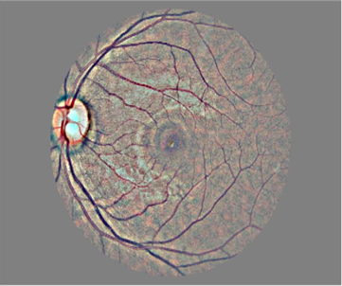
Predicting Stage Of Diabetic Retinopathy
Submitted By:
Jayasurya J
Kaarthik Saran.S
Shama M
Soorya Prakash Parthiban

Slide 2
Abstract:
Diabetic retinopathy is an eye disease caused by diabetes that can lead to loss of vision or even complete blindness.
The early detection of diabetic retinopathy occurrence can be very helpful for clinical treatment.
Hence here in this Project we are using Deep Learning’s Convolution Neural Network (CNN) algorithm to predict whether the retina Diabetic Retinopathy or not.

Slide 3
Basic Process:
The automatic detection of diabetic retinopathy is of vital importance, as it is the main cause of irreversible vision loss in the working-age population in the developed world
Diabetic retinopathy is a leading cause of blindness among working-age adults. Early detection of this condition is critical for good prognosis. Hence we use this project to predict the stage of diabetic retinopathy of the patient to proceed with his further diagnoses.
Data Collection
01
Diabetic Retinopathy dataset is taken from Kaggle
Data Preprocessing
02
Subtracted the local average colour average to 50% grey
Model Training
03
CNN algorithm is used for training
Flask
04
To Deploy and we create User Interface

Slide 4
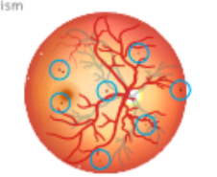
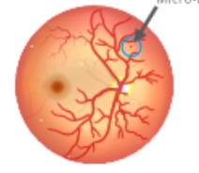

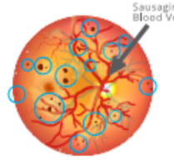
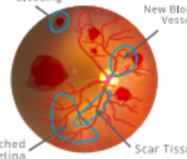
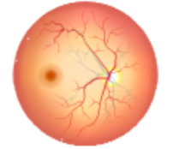
Data Collection
Diabetic Retinopathy Detection data from Kaggle is used here.
Dataset has size 82GB
The Stages of Diabetic Retinopathy given in dataset are of 5 types -
2.Mild
3.Moderate
Diabetic Retinopathy
1.No Diabetic Retinopathy
5.Proliferative
4.Severe

Slide 5
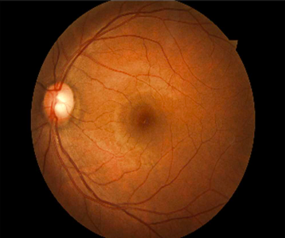
Data preprocessing
We Subtracted the local average colour
We matched the average to 50% grey
We increased the sharpness
BEFORE
AFTER

Slide 6
Model Training: CNN algorithm
To recognise an image with highest level of accuracy we need to use deep learning algorithms like convolutional neural networks.
CNNs can be thought of automatic feature extractors from the image. While using an algorithm with pixel vector we lose a lot of spatial interaction between pixels, a CNN effectively uses adjacent pixel information to effectively down sample the image first by convolution and then uses a prediction layer at the end.
Due to these features of CNN we get highest accuracy level for our model and has achieved an efficient intelligent album creator.

Slide 7
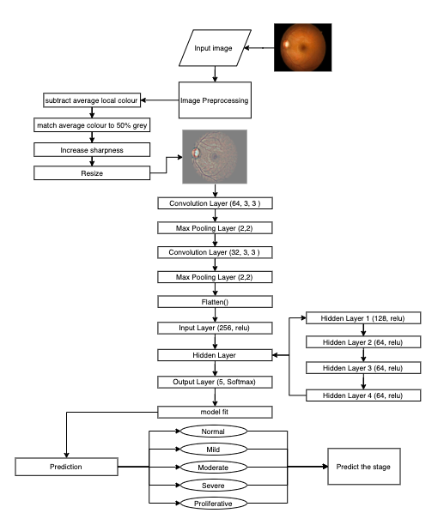
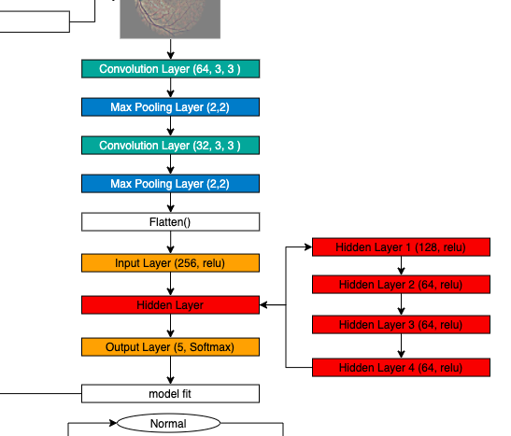
Model Training: CNN algorithm

Slide 8
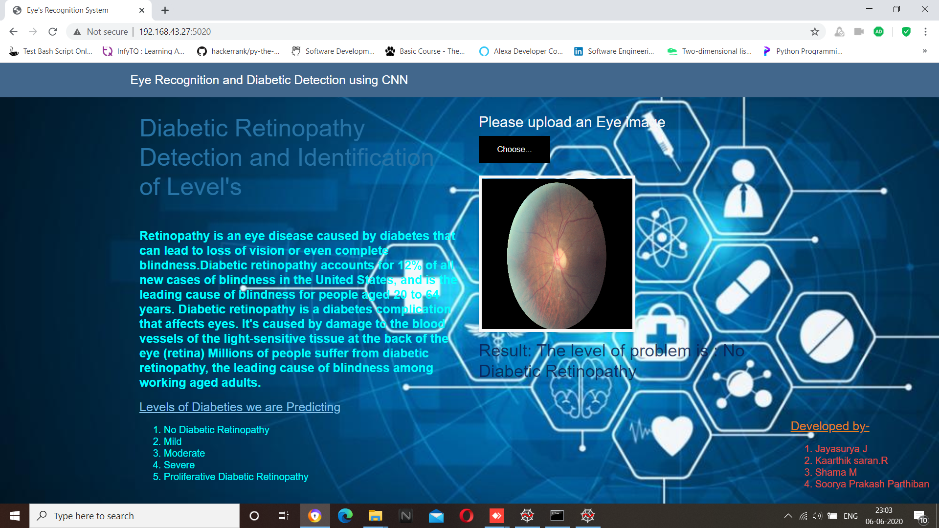
Flask:
Using flask we deploy the model
Our UI

Slide 9
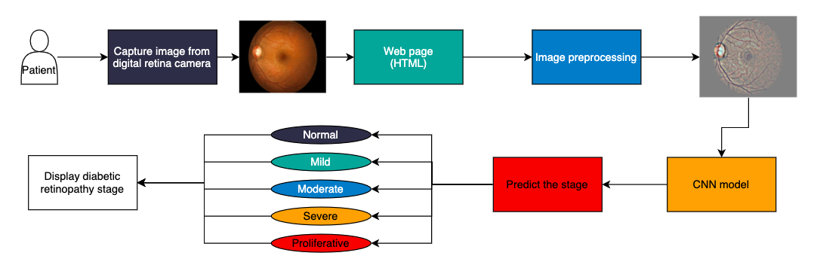
Block Diagram:

Slide 10
RESULT:
We got an accuracy of 0.82 which is good measure for a Convolution Neural Network.
The Model predicts the stage of Diabetic Retinopathy with good efficiency.

Slide 11
Advantages & Disadvantages:
Future scope:
Advantages:
Effective diabetic retinopathy prediction
Easily accessible for all patients who need to be screened
Efficiency is maintained by updating the dataset
Disadvantages:
Digital Retinal Camera is highly essential
Updating the dataset is a tedious process
Cost of Digital Retinal Camera is high
Diabetic retinopathy progresses with the duration of disease and often results in proliferative retinopathy this can also be predicted.
Using Diabetic retinopathy we could predict time by which a diabetic patient would go to next stage of Diabetic retinopathy.

Slide 12
THANK YOU

